Slide 1
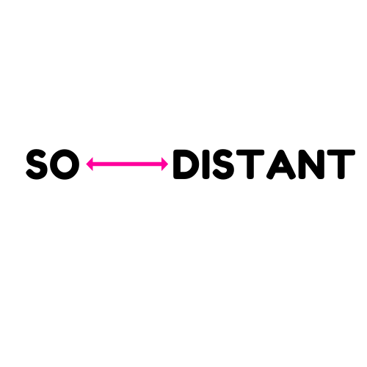

Social Distancing Detection

Slide 2
Objectives
As businesses gradually reopen post Covid pandemic, it has become essential to ensure that social distancing is being followed.
Currently most businesses have dedicated employees who manually monitor customer capacity and ensure that customers follow social distancing norms set by government guidelines.
Since this process is mostly manual, we propose SoDistant – a Computer Vision tool which provides following features:
Real time social distancing detection
Real time graphs for violations
Email alert to business owners upon violations exceed threshold

Slide 3
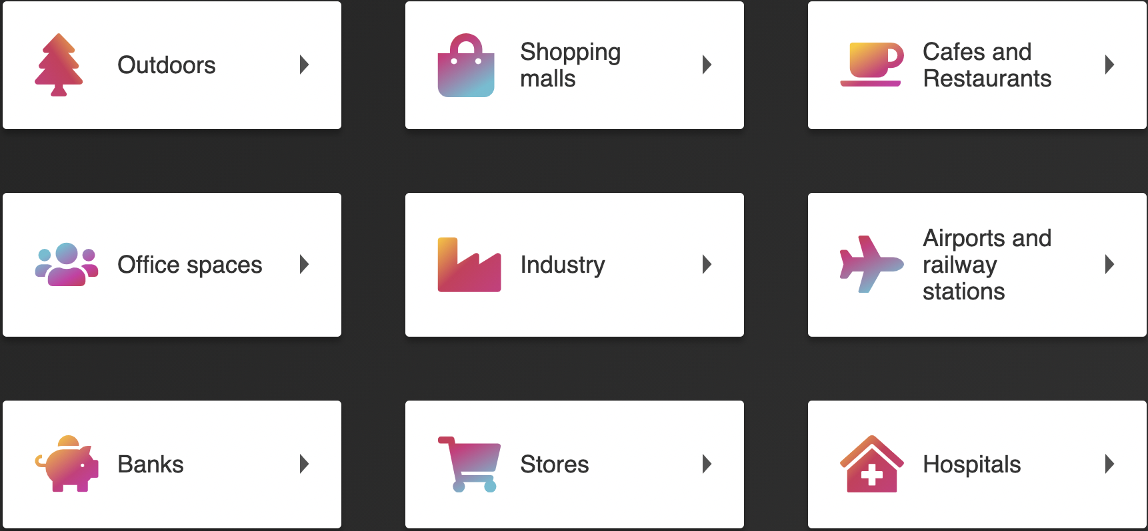
Target Users

Slide 4
DEMO : https://drive.google.com/file/d/1eiDqGXK8l0hncW2PHYde4KiUXbs3ena6/view?usp=sharing

Slide 5
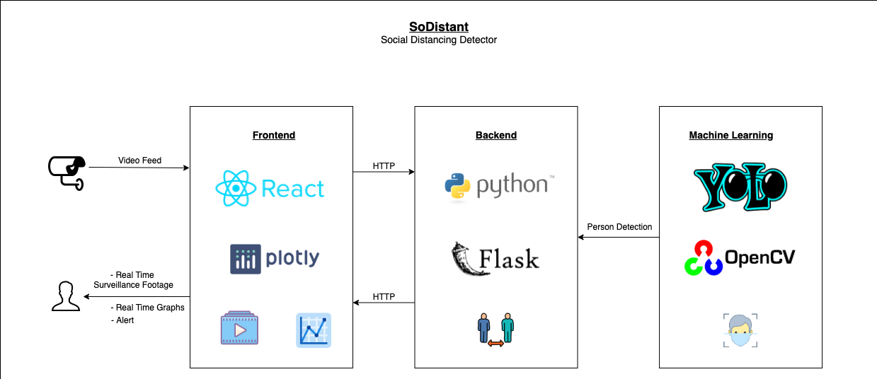
Architecture Diagram

Slide 6
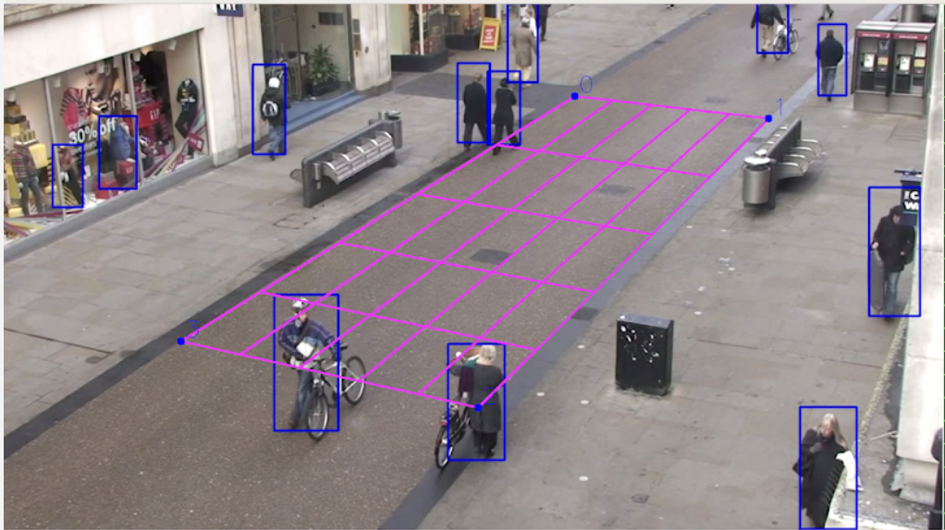
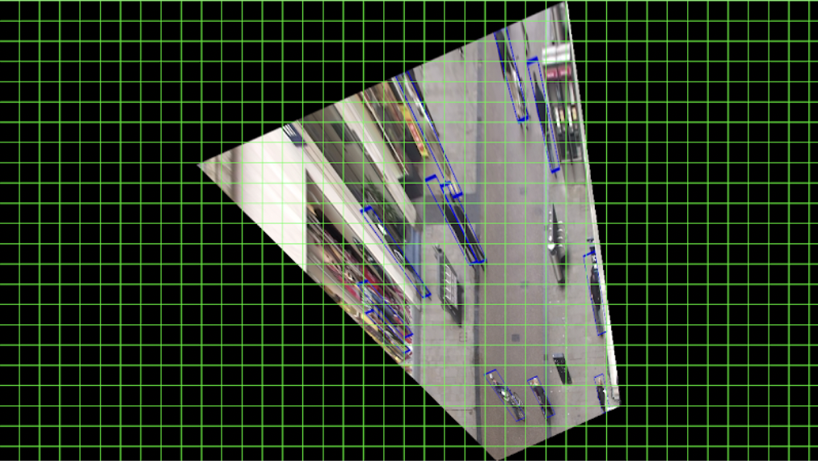
Further Improvements
Birds eye view
Face mask detection
Alerts for visitors
Integration with government guidelines to include dynamic updates to social distancing norms
Notes:
Image Source: https://landing.ai/landing-ai-creates-an-ai-tool-to-help-customers-monitor-social-distancing-in-the-workplace/

Slide 7
Thank You

